Slide 1
Smart Grid Electrical System in Unity
By Alex Estrada

Slide 2
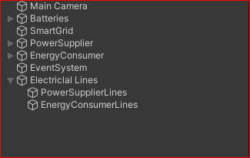
Smart Grid
An advanced electrical system that uses digital communication and automation to improve the management and distribution of electricity.
Components
Power Suppliers
Batteries
Energy Consumers
Smart Grid Controller

Slide 3
Description and Motivation
Similarity to a Distributed System
Multiple Components
These nodes work together
Decentralized
Self-Healing
Interactivity

Slide 4
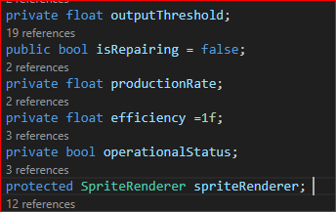
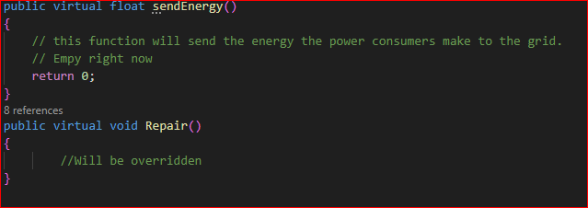
Power Suppliers
Components that provide power to the system
Operational Status: Monitors if the power supplier is working or needs repair.
Energy Production: Sets and adjusts energy production rate.
Efficiency: Adjusts the production efficiency based on conditions.
Repairs: Includes a repair method that restores functionality after a failure.
Visual Feedback: Uses color change to indicate status (white for operational, black for failure).Monitoring: Repeated checks for operational status.

Slide 5
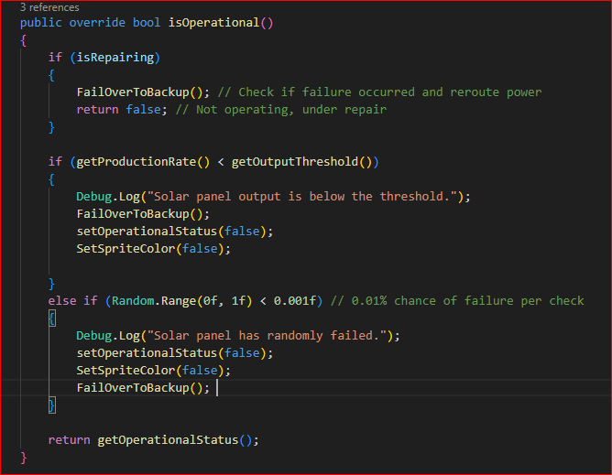
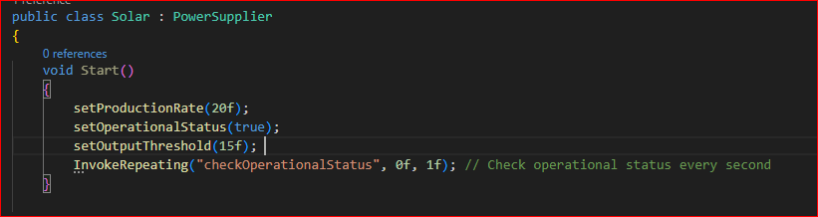
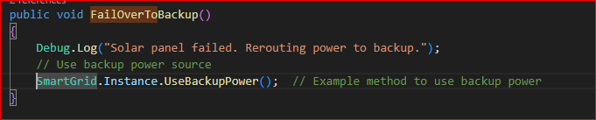
Solar class (Power Supplier Child Example)

Slide 6
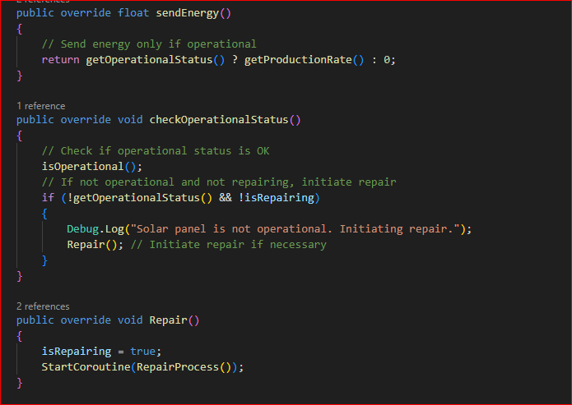
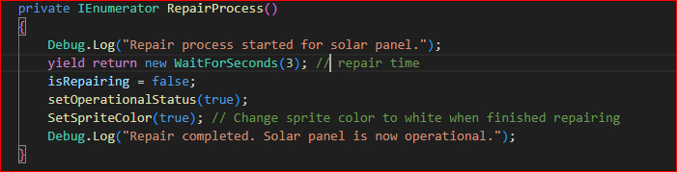

Slide 7
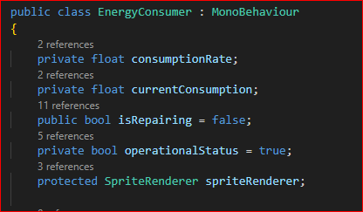
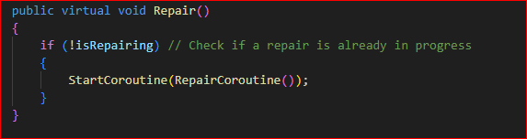
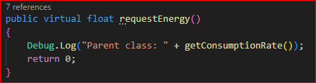
Energy Consumer
Consumer energy distributed by the smart grid
Energy Consumption: Determines how much energy the consumer needs from the grid.
Operational Status: Tracks if the consumer is operational and uses visual feedback (sprite color).
Energy Requests: Handles the energy demand from the grid through the requestEnergy method.
Repairs: Includes a repair method that restores functionality after a failure.
Visual Feedback: Uses color change (white for operational, black for failure) to represent status.
Monitoring: Can periodically check the operational status of the energy consumer.

Slide 8
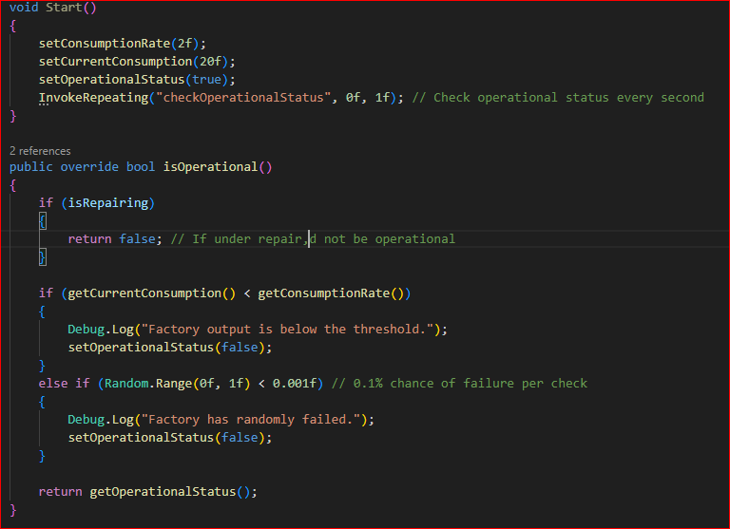
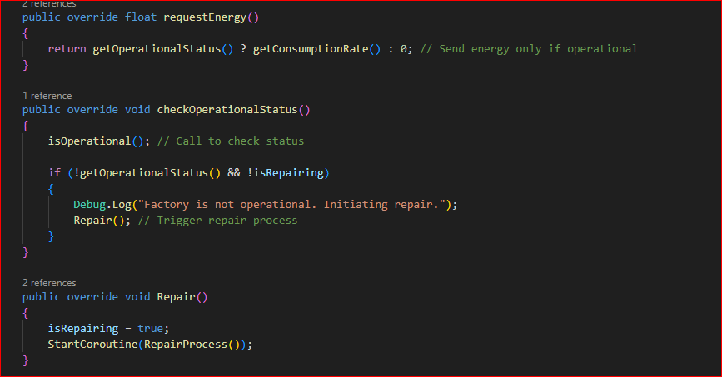
Factory Class (EnergyConsumer Child class Example

Slide 9
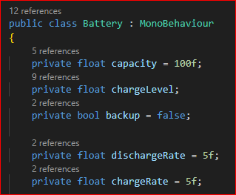
Batteries
Energy Storage Units
Energy Storage: Stores energy from the grid; capacity defines storage capacity, and chargeLevel tracks current energy.
Backup Mode: The backup flag indicates when the battery is providing backup energy to the grid.
Charge and Discharge: Energy is received and discharged at set rates, controlled by chargeRate and dischargeRate.
Energy Flow: The battery stores excess energy and provides it when suppliers are not operational.
Capacity and Charge Management: Ensures energy is added or removed within the battery’s capacity limits.

Slide 10
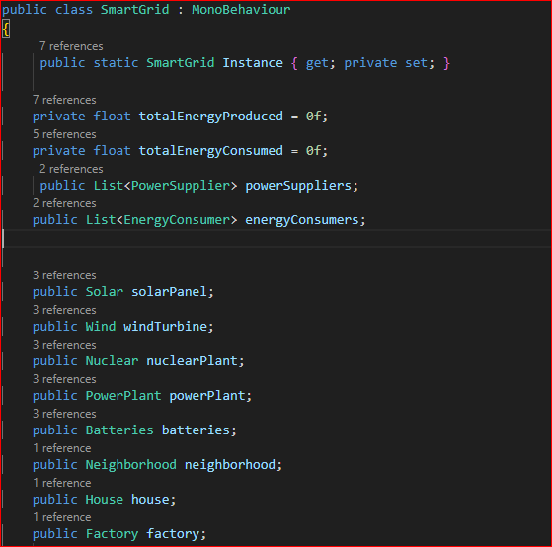
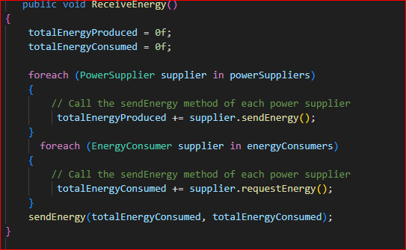
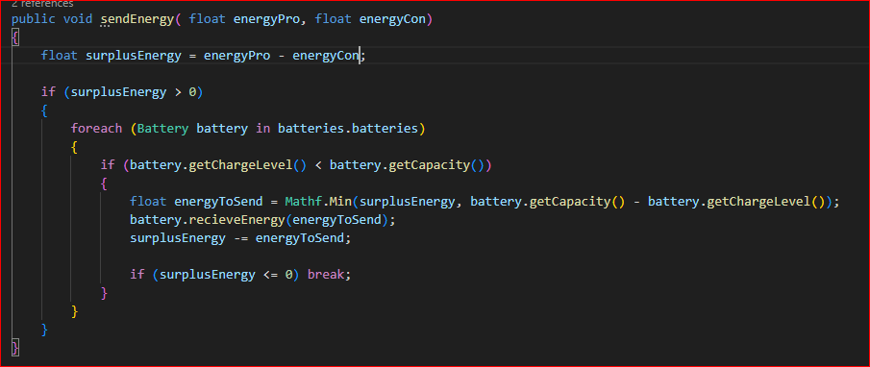
Smart Grid Controller

Slide 11
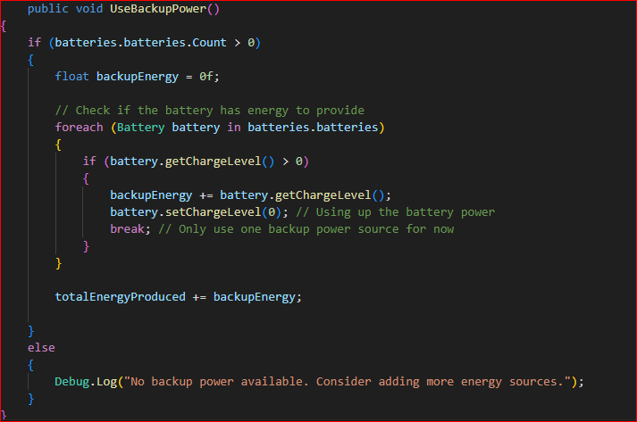
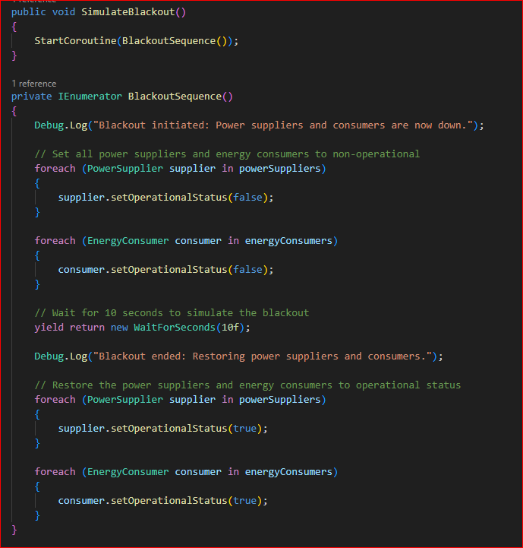

Slide 12
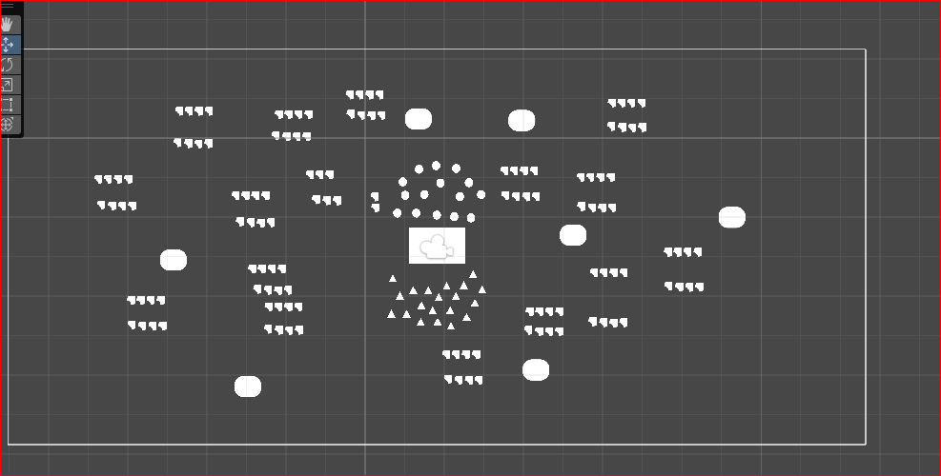
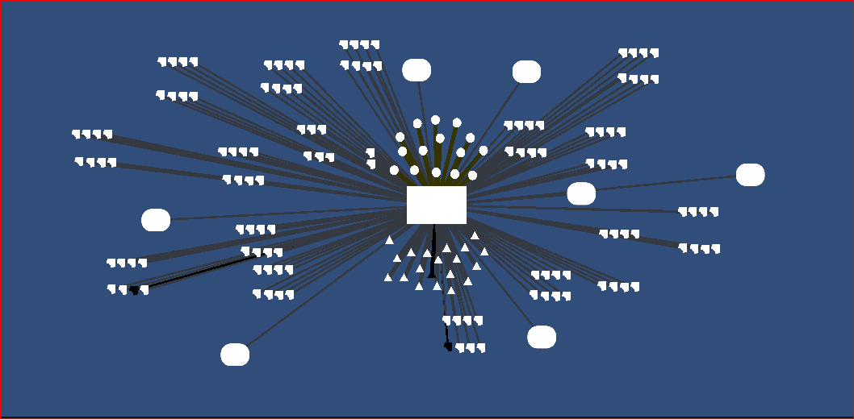
Visualization

Slide 13

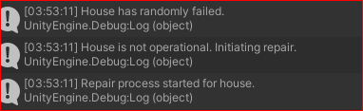


Visualization

Slide 14

Visualization

Slide 15

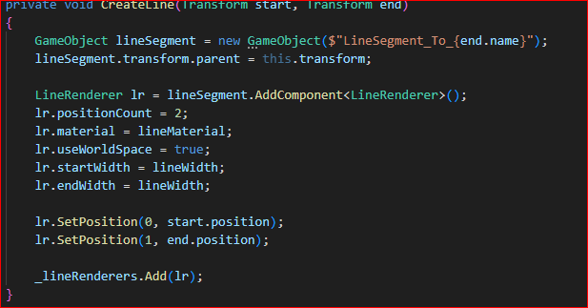
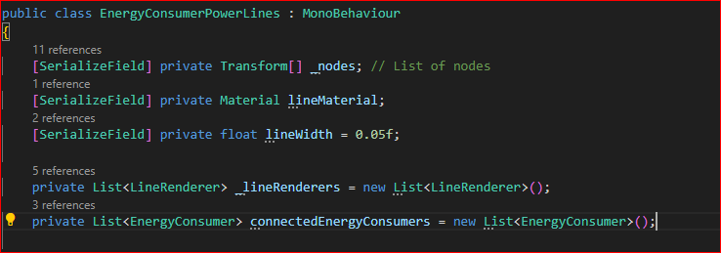

Slide 16
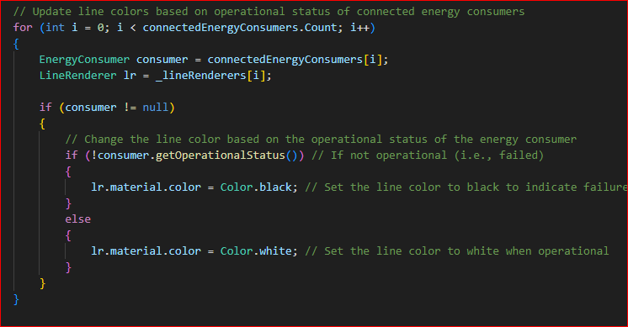
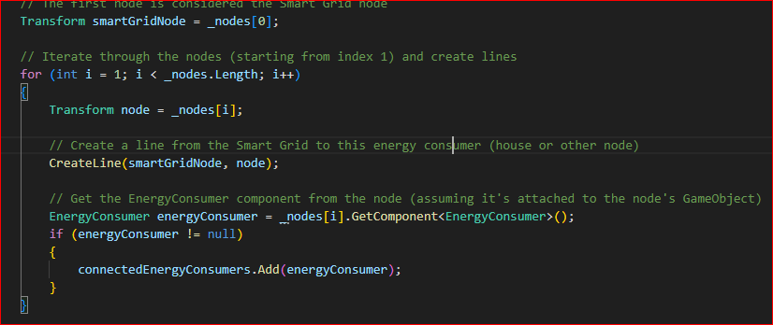

Slide 17
References
https://www.geeksforgeeks.org/what-is-a-distributed-system/
https://docs.unity3d.com/Manual/class-LineRenderer.html
chat.openai.com
www.learn.unity.com

